Slide 1

Statistical Analyses on S&P 500 Index
Presented by GROUP G
YE, Yifan 20551471
LI, Jiahao 20568357
HUANG, Zhenzhen 20568058
XIE, Hao 20568644
CHENG, Qing 20567494
Notes:
亮亮图文旗舰店
https://liangliangtuwen.tmall.com

Slide 2
CONTENT
01
02
03
04
05
Introduction
Linear Regression Model Construction
Linear Regression Model Diagnostics
ANOVA
Machine Learning

Slide 3
01
Introduction
Background
Data Exploration
Data Preprocessing

Slide 4
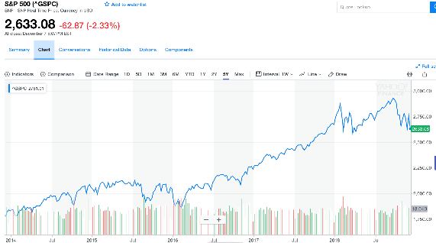
Background
S&P 500 Index
A free float-adjusted market capitalization-weighted stock market index in the United States.
Record and monitor daily changes of the largest companies of the American stock market.
The movement of S&P 500 in five years

Slide 5
Background
Potential candidate financial indexes
‘FTSE100’: A stock index for London Stock Exchange with 100 companies’ stocks
'NIKKEI225’: A stock index for the Tokyo Stock Exchange
'USD-GBP’: British Pound-US Dollar exchange rate
'USD-JPY’: Japanese Yen-US Dollar exchange rate
'DJIA’ : Dow Jones Industrial Average
'NASDAQ’: A stock index including common stocks and similar securities listed on the NASDAQ stock market
'GOLD PRICE’: Commodity price of gold
'crude oil’’: Commodity price of crude oil
'SSECOPOSITE(IN USD)‘: A stock market index of all stocks (A shares and B shares) that are traded at the Shanghai Stock Exchange
'HSI’: Index of Hangseng

Slide 6
Background
Data: 2010-2018 return values of S&P daily closing price
Purpose:
To find out relationships among the return value of S&P 500 index and other kinds of financial data
To explore the difference between mean return values from different years
To predict the up and downs of the index by different statistical methods

Slide 7
Data Exploration
Data
Distribution
Statistic indexes
Outliers
Boxplot
Time changing
Line chart

Slide 8
Data Exploration
Data Information of Financial Indexes
01
The Return of S&P500
02
Relationship Between Financial Indexes and S&P500
03

Slide 9
Data Exploration
Data Information of Financial Indexes
 | FTSE100 | NIKKEI225 | USD-GBP | USD-JPY | DJIA | NASDAQ | GOLD PRICE | crude oil | SSECOPOSITE(IN USD) | HSI
mean | 9567.89 | 147.30 | 0.67 | 100.29 | 16581.41 | 4373.00 | 1342.74 | 74.35 | 431.64 | 3000.24
std | 885.87 | 29.53 | 0.06 | 14.59 | 4413.28 | 1615.18 | 186.13 | 22.37 | 85.11 | 387.04
min | 7093.83 | 103.23 | 0.58 | 75.82 | 9686.48 | 2091.79 | 1051.10 | 26.55 | 314.68 | 2231.71
25% | 8915.31 | 118.58 | 0.63 | 84.20 | 12727.38 | 2893.38 | 1219.27 | 51.54 | 366.72 | 2735.81
50% | 9539.30 | 146.98 | 0.65 | 102.36 | 16458.11 | 4351.16 | 1286.74 | 77.18 | 426.34 | 2950.59
75% | 10153.27 | 165.43 | 0.72 | 112.18 | 18403.60 | 5218.22 | 1407.00 | 94.89 | 471.24 | 3157.98
max | 11772.46 | 219.22 | 0.82 | 125.63 | 26743.50 | 8109.69 | 1897.46 | 112.86 | 832.07 | 4241.01

Slide 10
Data Exploration
Boxplot of Financial Indexes

Slide 11
Data Exploration
The return of S&P 500
 | sp500
mean | 0.00
std | 0.01
min | -0.07
25% | -0.00
50% | 0.00
75% | 0.01
max | 0.05

Slide 12
Data Exploration
Plot of daily return value of S&P 500 closing price

Slide 13
Data Exploration
Correlation between Financial Indexes and S&P500
 | sp500 | FTSE100 | NIKKEI225 | USDGBP | USDJPY | DJIA | NASDAQ | GOLDPRICE | crudeoil | SSECOPOSITE | HSI
sp500 | 1.000000 | 0.622389 | 0.053860 | -0.278938 | 0.287327 | 0.972714 | 0.951640 | 0.002853 | 0.362548 | 0.143730 | 0.209138
FTSE100 | 0.622389 | 1.000000 | 0.201320 | -0.503433 | 0.173049 | 0.619389 | 0.571856 | 0.082637 | 0.403513 | 0.226160 | 0.410482
NIKKEI225 | 0.053860 | 0.201320 | 1.000000 | -0.101947 | -0.082606 | 0.049759 | 0.057463 | 0.075006 | 0.058270 | 0.277371 | 0.475025
USDGBP | -0.278938 | -0.503433 | -0.101947 | 1.000000 | 0.115947 | -0.273960 | -0.246273 | -0.207499 | -0.231286 | -0.055074 | -0.099395
USDJPY | 0.287327 | 0.173049 | -0.082606 | 0.115947 | 1.000000 | 0.291179 | 0.279466 | -0.326821 | 0.077894 | 0.079287 | 0.186918
DJIA | 0.972714 | 0.619389 | 0.049759 | -0.273960 | 0.291179 | 1.000000 | 0.896667 | -0.016986 | 0.346903 | 0.137925 | 0.198343
NASDAQ | 0.951640 | 0.571856 | 0.057463 | -0.246273 | 0.279466 | 0.896667 | 1.000000 | -0.004042 | 0.305553 | 0.161116 | 0.228454
GOLDPRICE | 0.002853 | 0.082637 | 0.075006 | -0.207499 | -0.326821 | -0.016986 | -0.004042 | 1.000000 | 0.170512 | 0.030287 | 0.014785
crudeoil | 0.362548 | 0.403513 | 0.058270 | -0.231286 | 0.077894 | 0.346903 | 0.305553 | 0.170512 | 1.000000 | 0.098702 | 0.147558
SSECOPOSITE | 0.143730 | 0.226160 | 0.277371 | -0.055074 | 0.079287 | 0.137925 | 0.161116 | 0.030287 | 0.098702 | 1.000000 | 0.552965
HSI | 0.209138 | 0.410482 | 0.475025 | -0.099395 | 0.186918 | 0.198343 | 0.228454 | 0.014785 | 0.147558 | 0.552965 | 1.000000

Slide 14
Data Exploration

Slide 15
Data Preprocessing
01
02
Construct new indexes
Outlier samples
04
03
Z-scores normalization
Missing Value
The range of different factors are not in the same magnitude.
Here using z-scores method to normalize the data.
Method1: Delete all the missing values.
Method2: Using the mean value to fill the missing values.

Slide 16
02
Linear Regression Model Construction
Model assumption
Model construction
Model selection

Slide 17
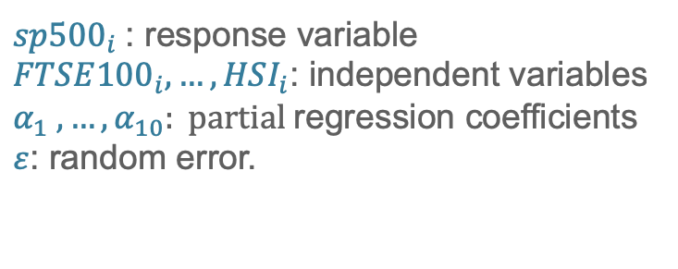
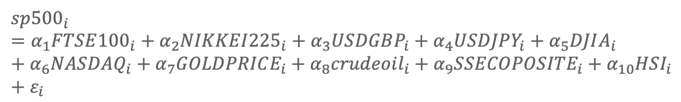
Multi-linear regression models
Multi-linear regression model
$$sp{500}_{i}=α_{1}FTSE{100}_{i}+α_{2}NIKKEI{225}_{i}+α_{3}USDGBP_{i}+α_{4}USDJPY_{i}+α_{5}DJIA_{i}+α_{6}NASDAQ_{i}+α_{7}GOLDPRICE_{i}+α_{8}crudeoil_{i}+α_{9}SSECOPOSITE_{i}+α_{10}HSI_{i}+ε_{i}$$
$sp{500}_{i}$: response variable
$FTSE{100}_{i}, …,HSI_{i}$: independent variables
$α_{1} ,…,α_{10}: partial$regression coefficients
$ε$: random error.

Slide 18
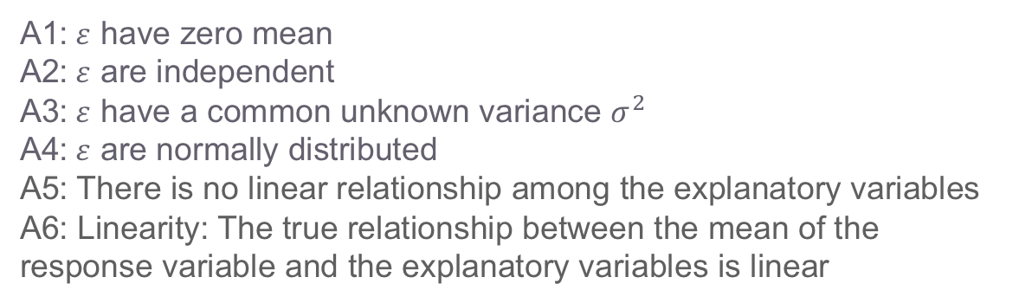
Multi-linear regression models
Model Assumption
A1:$ε$ have zero mean
A2:$ε$ are independent
A3:$ε$ have a common unknown variance $σ^{2}$
A4:$ε$ are normally distributed
A5: There is no linear relationship among the explanatory variables
A6: Linearity: The true relationship between the mean of the response variable and the explanatory variables is linear

Slide 19
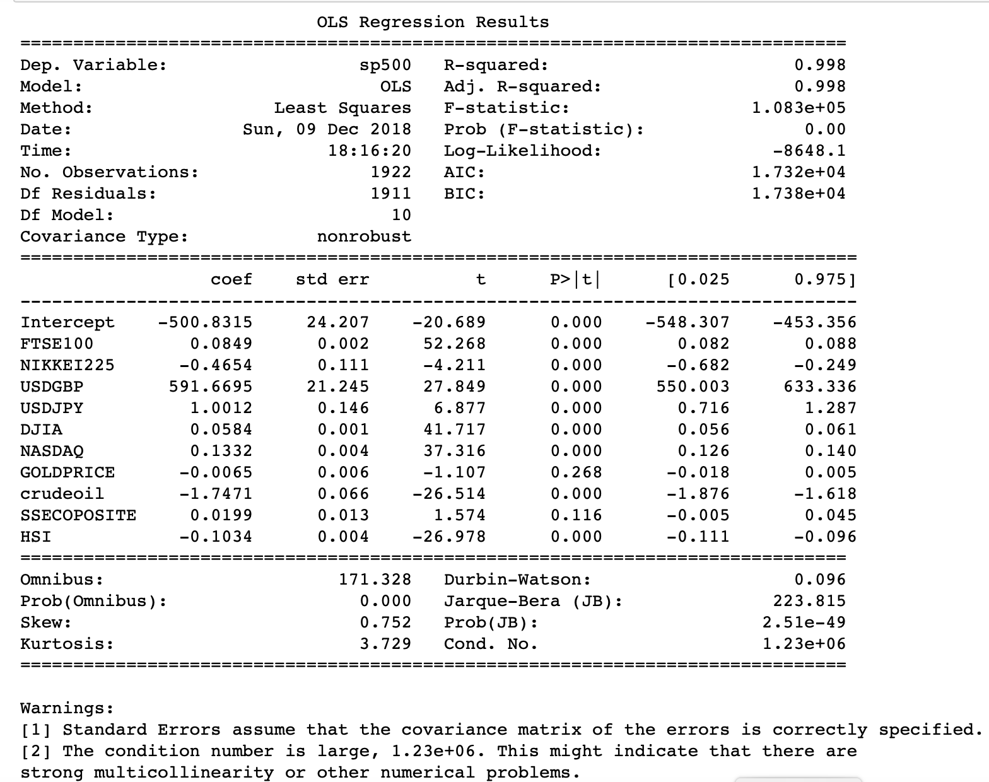
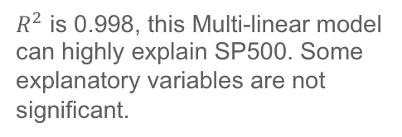
Multi-linear regression
Model Construction
lreg = smf.ols("sp500~FTSE100+NIKKEI225+USDGBP+USDJPY+DJIA+NASDAQ+GOLDPRICE+crudeoil+SSECOPOSITE+HSI",return_df).fit()
print(lreg.summary())
$R^{2}$ is 0.998, this Multi-linear model can highly explain SP500. Some explanatory variables are not significant.

Slide 20
Multi-linear regression models
Model selection
method | Best score | variable
AdjR2 | 0.998229 | All Variables
AIC | 17316.9 | FTSE100, NIKKEI225, DJIA, USDJPY, USDGBP, NASDAQ, crudeoil, HSI
BIC | 17366.9 | FTSE100, NIKKEI225, DJIA, USDJPY, USDGBP, NASDAQ, crudeoil, HSI
From the best subset selection methods above, we can choose FTSE100, NIKKEI225, DJIA, USDJPY, USDGBP, NASDAQ, crudeoil, HIS as explanatory variables.

Slide 21
Multi-linear regression models
By using forward selection:
AIC best score: 17316.9
Variables: FTSE100, NIKKEI225, DJIA, USDJPY, USDGBP, NASDAQ, crudeoil, HSI
By using backward selection:
AIC best score: 17316.9
Variables: FTSE100, NIKKEI225, DJIA, USDJPY, USDGBP, NASDAQ, crudeoil, HSI
Summary:
Different methods on AIC score are consistent with each other, the final model selected include FTSE100, NIKKEI225, DJIA, USDJPY, USDGBP, NASDAQ, crudeoil, HSI.

Slide 22
03
Linear Regression Model Diagnostics
Model diagnostics
Model remedies

Slide 23
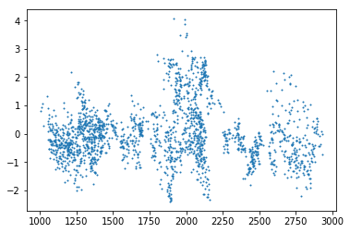
Multi-linear regression models
Externally studentized residual plot (A3, assumption of constant variances)
Conclusion: There is some patterns of the externally studentized residual. So the assumption of constant variance should be suspected.

Slide 24
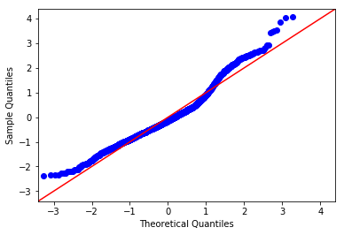
Multi-linear regression models
Q-Q plot: (A4, assumption of normal distribution)
Conclusion:
From the qq plot, we suspect the assumption of a normal distribution.
Then we do normality test of extresid.

Slide 25
Multi-linear regression models
Normality test of externally studentized residual
Test method | Statistic | p-value / Critical Value
Shapiro-Wilk test | 0.9604 | 1.7757e-22
K-S test | 0.0845 | 2.1014e-12
Anderson-Darling test | 25.0873 | [0.575, 0.655, 0.785, 0.916, 1.09 ] [15. , 10. , 5. , 2.5, 1. ]
For Shapiro-Wilk test and K-S test, p-values are smaller than corresponding significant level (0.15, 0.1, 0.05, 0.025, 0.01), so we conclude that the H0 should be rejected.
For the Anderson-Darling test, the statistic is larger than corresponding critical values at different significant level as above. So we draw the same conclusion as previous tests.

Slide 26
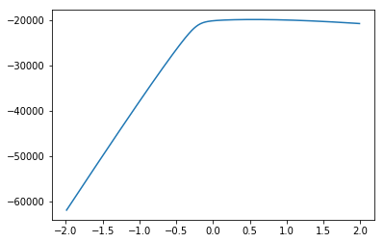
Multi-linear regression models
Box-Cox transformation
We choose lambda to be 0.55.

Slide 27
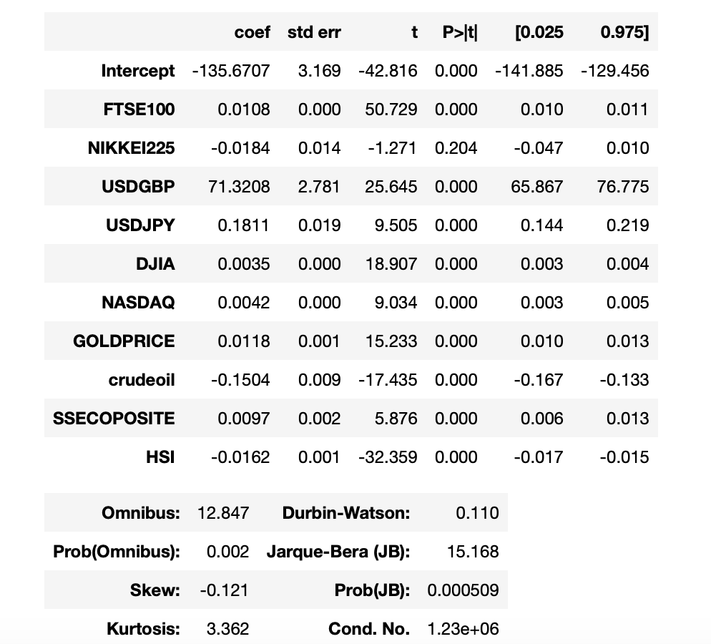
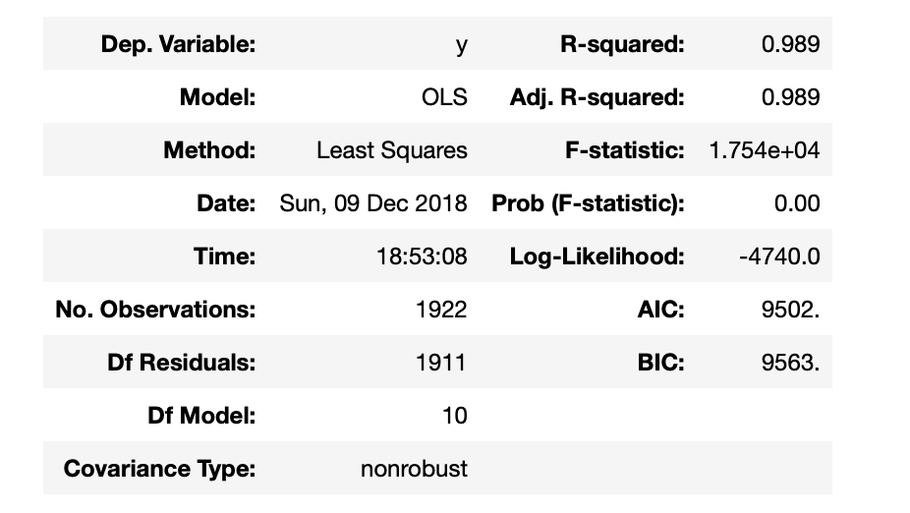
Multi-linear regression models
We fit a new OLS model after Box-Cox transformation

Slide 28
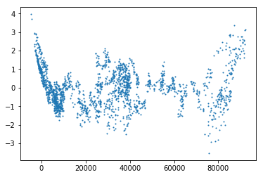
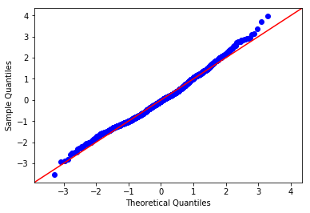
Multi-linear regression models
Externally studentized residual plot and Q-Q plot after box_cox transform:

Slide 29
Multi-linear regression models
Normality test of extresid after B-C transformation
Test method | statistic | p-value
Shapiro-Wilk test | 0.9914 | 3.1467e-9
K-S test | 0.0397 | 0.0045
Anderson-Darling test | 4.5914 | [0.575, 0.655, 0.786, 0.916, 1.09 ] [15. , 10. , 5. , 2.5, 1. ]
It shows that the transformation doesn’t work.

Slide 30
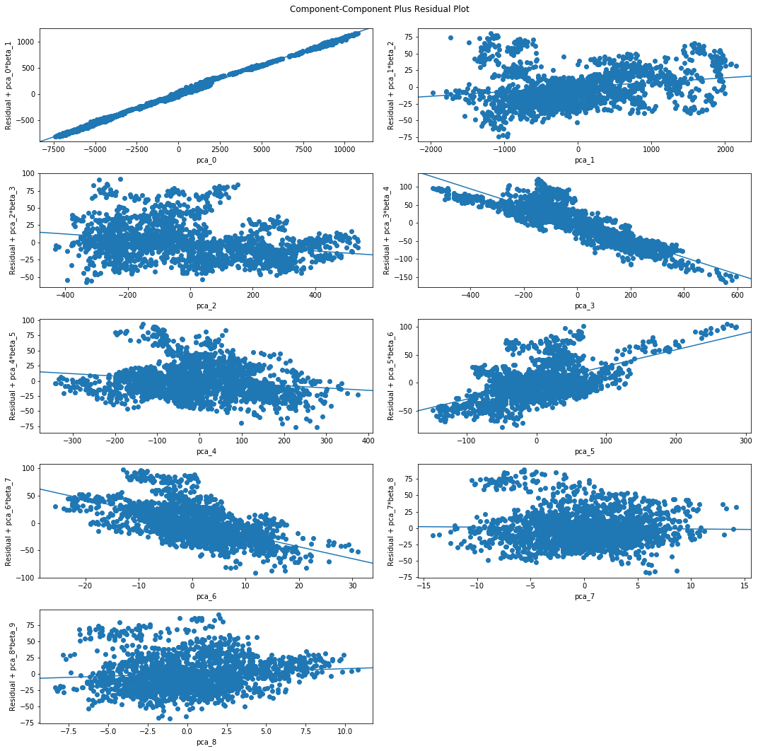
Multi-linear regression models
Assessing nonlinearity (A6)
The relationships between some variables
and the response are not linear.

Slide 31
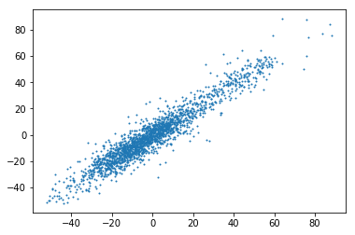
Multi-linear regression models
Diagnostic independence (A1)
Durbin-Watson Statistic: 0.0958

Slide 32
Multi-linear regression models
Remedy – Time series model
⚈ We can check if the process we are dealing with is a stationary
process by checking the existence of unit roots.
⚈ Here we use Augmented Dickey-Fuller (ADF) test for this purpose.
⚈ We can also check if the process is a white noise. Because white
noise will not provide any useful message.
⚈ We will use Ljung-Box test to achieve this goal.

Slide 33
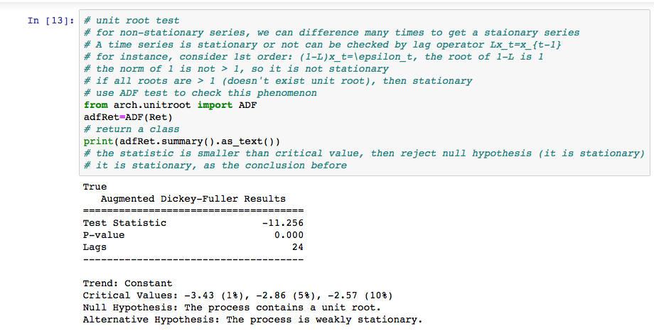
Multi-linear regression models
We make use of the package “arch”. The result below shows that
the return of S&P 500 is (weak) stationary.

Slide 34
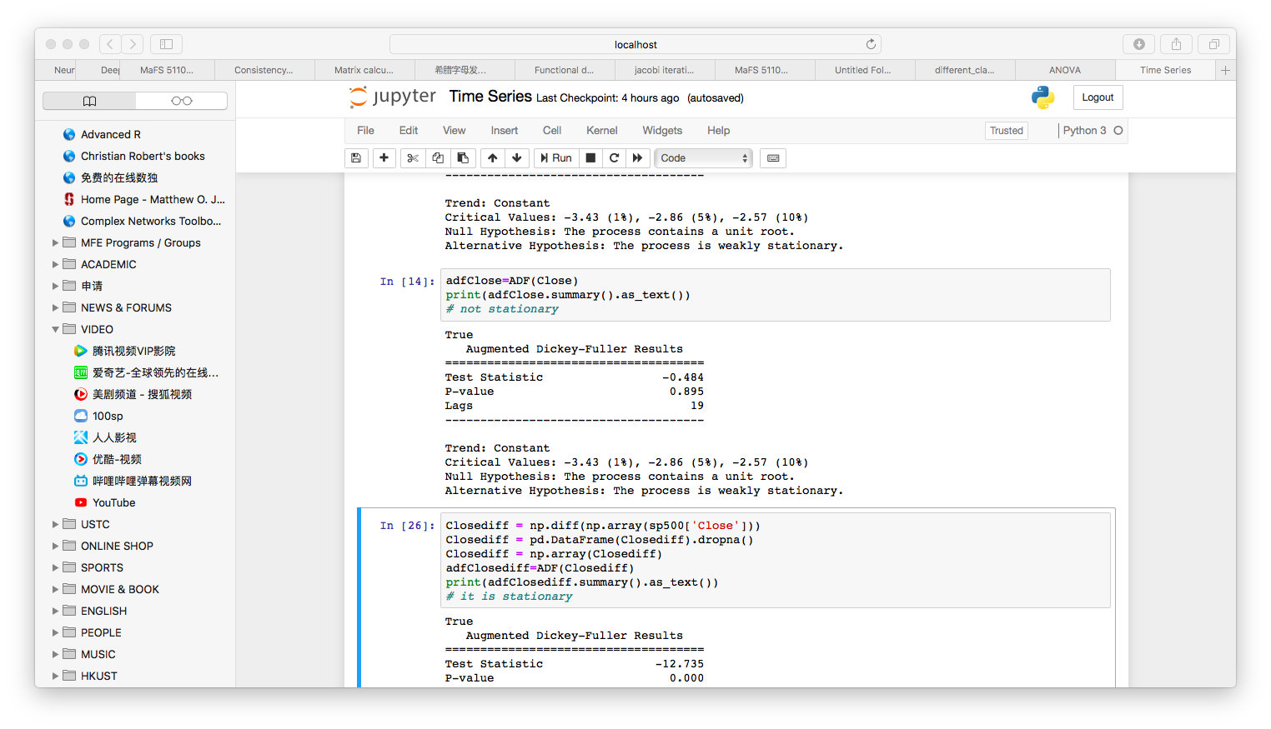
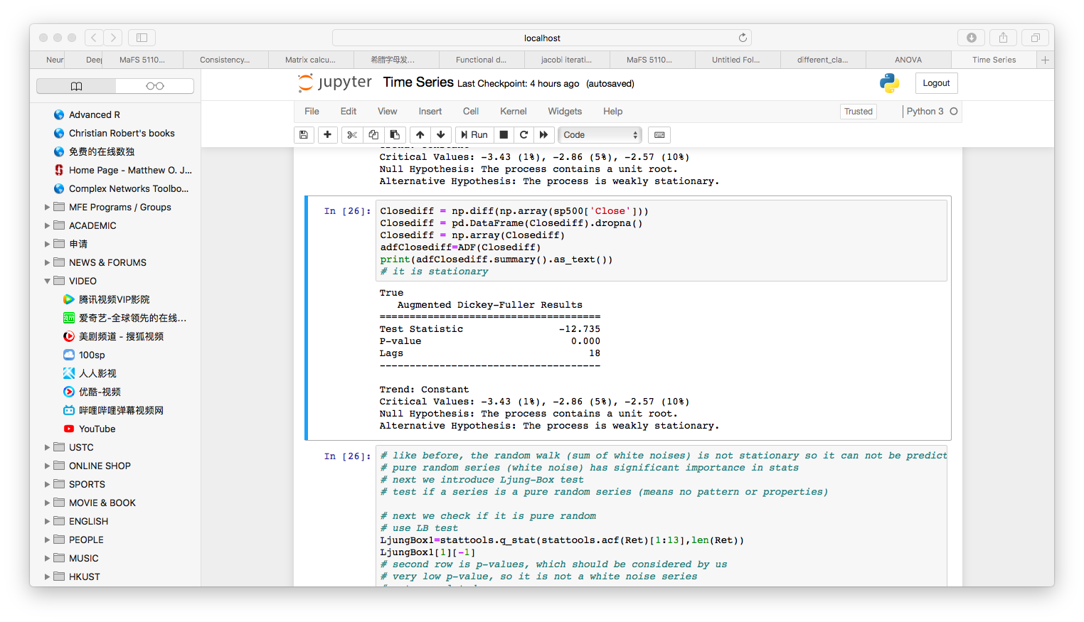
Multi-linear regression models
⚈ The close price as a process is
not stationary (p-value = 0.895).
⚈ We consider the first order
difference and then it becomes
stationary. (p-value is almost zero)

Slide 35
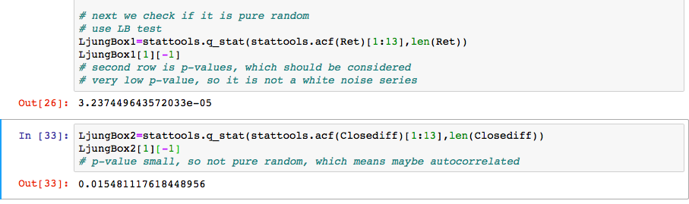
Multi-linear regression models
We make use of the package “statsmodels”. The Ljung-Box test
shows that the return process is not a pure random process. Because
of a very low p-value 3.237449643572033e-05. Besides, the first order
difference process is also not a pure random process under 0.1 or 0.05
significance level.

Slide 36
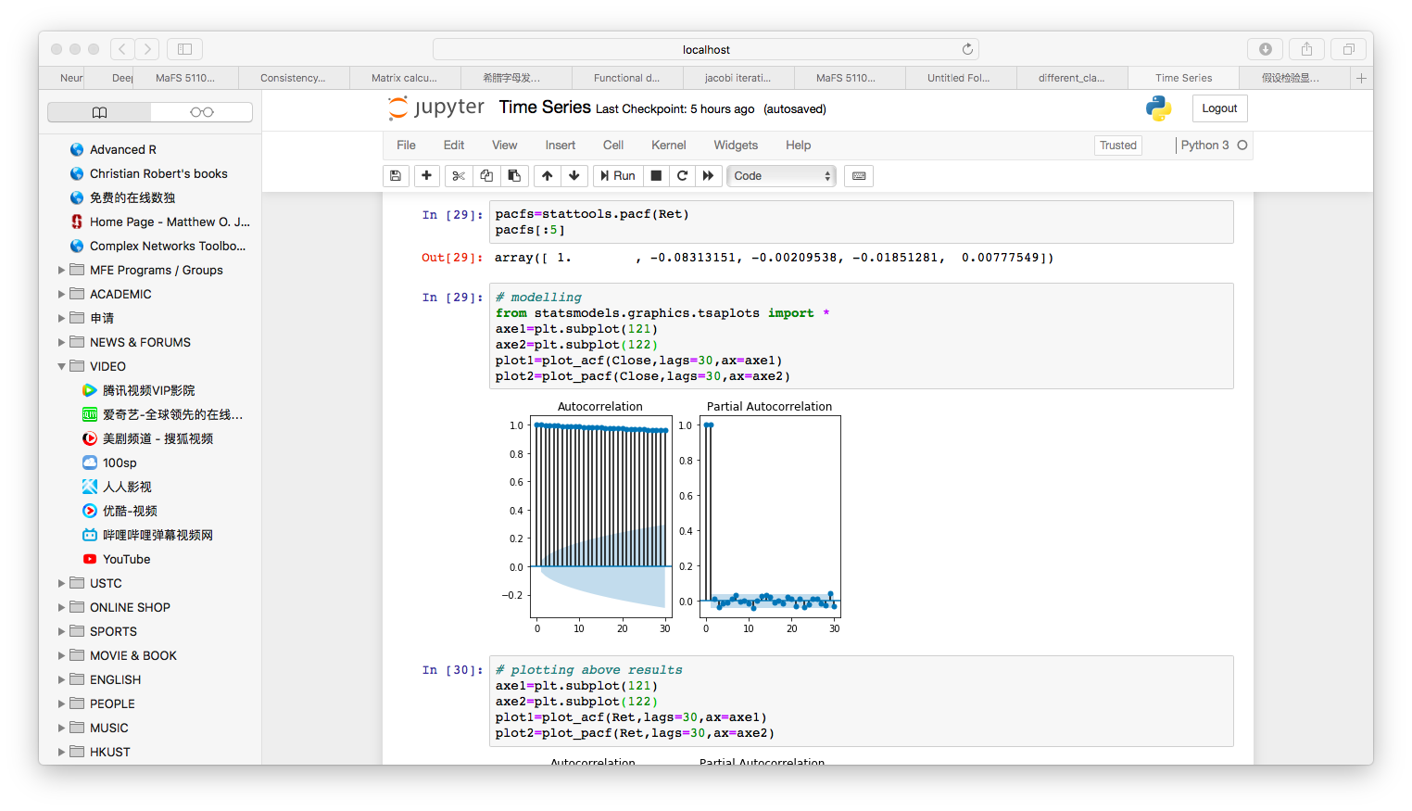
Multi-linear regression models
⚈ We give the ACF and PACF plots of the close price process below.

Slide 37
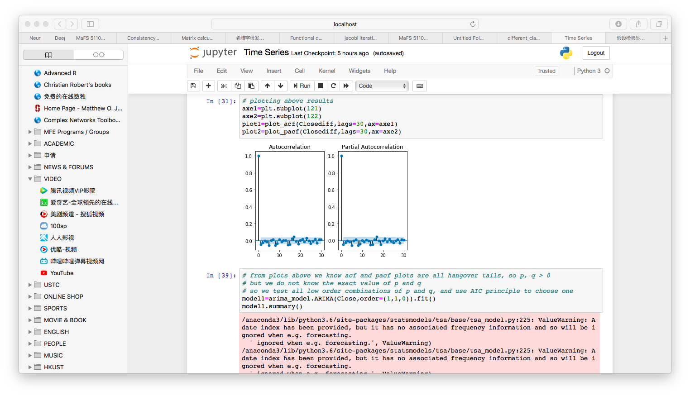
Multi-linear regression models
⚈ We give the ACF and PACF plots of the first order difference of the
close price process below.

Slide 38
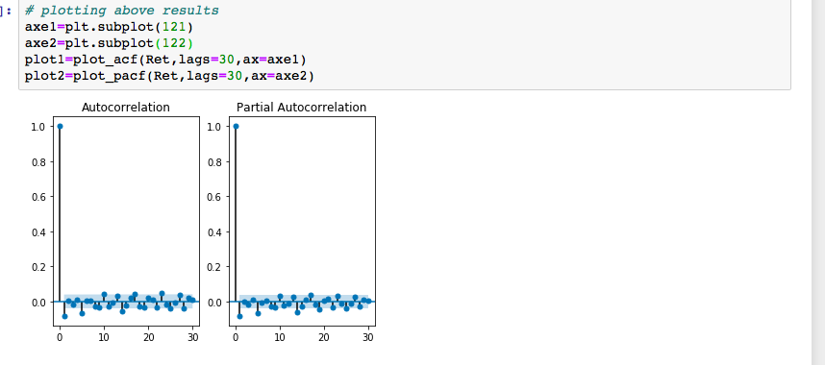
Multi-linear regression models
⚈ We give the ACF and PACF plots of the return process below.

Slide 39
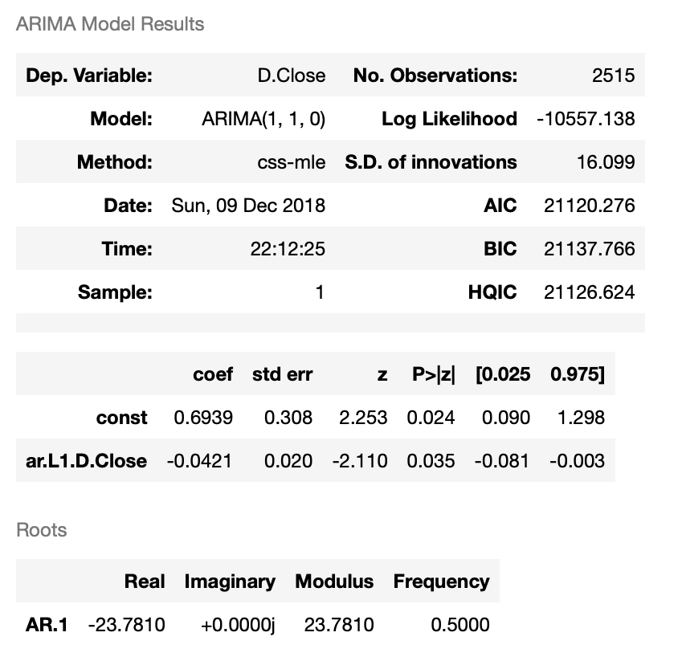
Multi-linear regression models
⚈ We can try a lot of time
series methods
⚈ For example, we can try
ARIMA(1,1,0)

Slide 40
Multi-linear regression models
Multicollinearity (A5)
Checking VIFs： 2362.6357, 8.3445, 42.9418, 7.2746, 18.1869,
153.8309, 133.9914, 4.8760, 8.7599, 4.6698, 8.8738
There are many variables that have a VIF exceeding 10,
so we drop the one with the largest VIF and fit a new model.
After dropping the variable with the largest VIF and get new VIFs:
2243.0302, 42.4006, 4.4940, 11.0908, 153.8268,
133.9413, 4.3872, 6.9141, 4.4210, 7.4071
After dropping the variable with the largest VIF several times,
the situation doesn’t get better, so we turn to other methods.

Slide 41
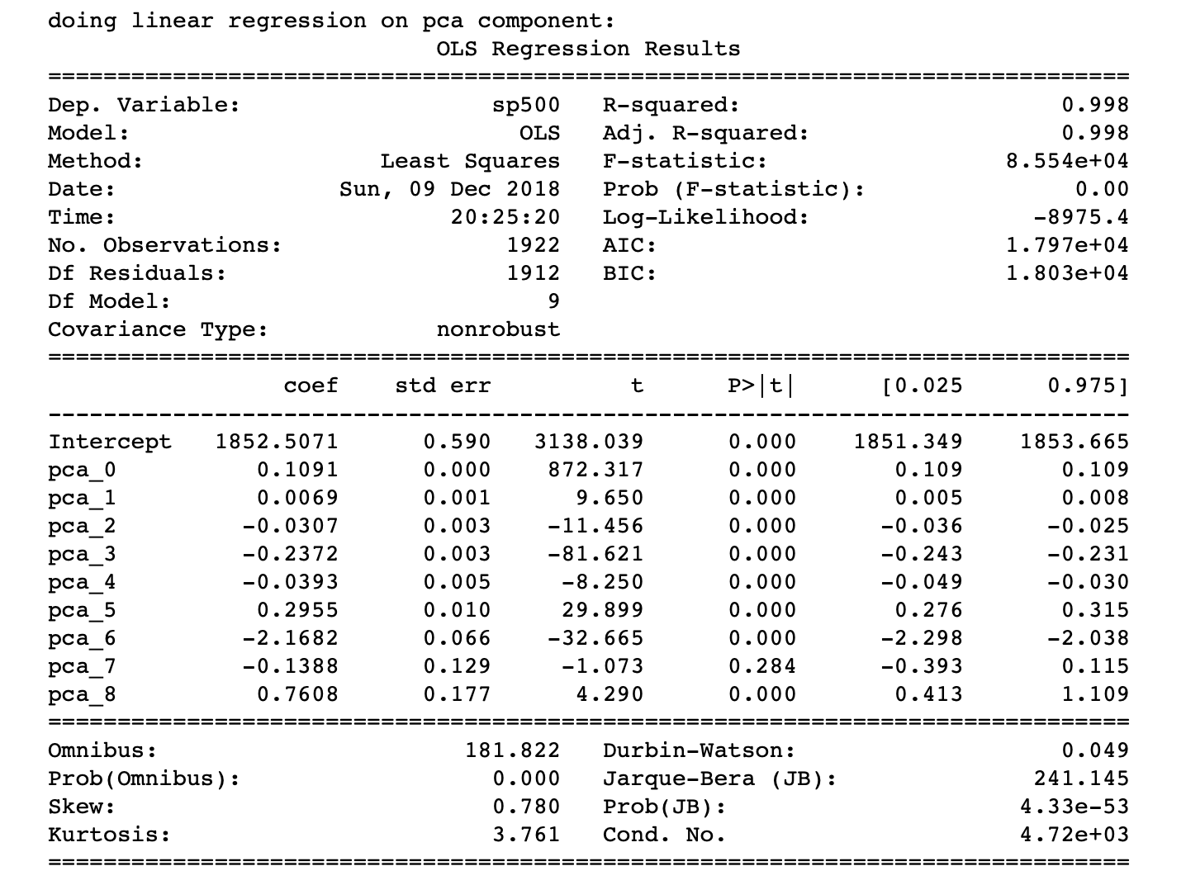
Multi-linear regression models
Principal component regression:
Accumulate variance ratios are:
[0.9656883 0.99527633 0.9973852
0.99917563 0.99984036 0.99999518
0.99999862 0.99999952 1. ]
for all the principal components.
Check VIFs after PCA:
[1.0, 0.9999999999999998,
1.0, 1.0, 0.9999999999999998,
1.0000000000000002, 1.0, 1.0, 1.0, 1.0]
No multicollinearity after PCA (obvious)

Slide 42
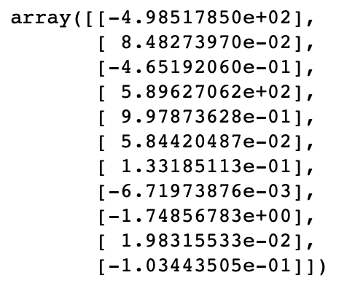
Multi-linear regression models
Ridge regression (penalty for coefficient)
In order to deal with multicollinearity,
we use ridge regression, which will
shrink some coefficients towards zero.
(coefficients are shown in the right)

Slide 43
04
ANOVA
Boxplot by year
Hypothesis test of group means
Model diagnostics

Slide 44
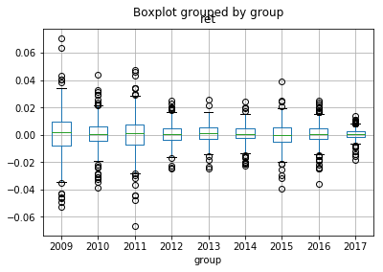
Boxplot by Year
ANOVA
Graphically we observe the same means for the 9 groups, although many outliers exist.

Slide 45
ANOVA
Source | d.f. | Sum of Squares (SS) | Mean sum of squares (MS) | F-value
Treatment / Between | 8 | 0.000222 | 0.00002775 | 0.254139456
Error / Within | 2255 | 0.246228 | 0.000109192
Total | 2263 | 0.24645
According to Python output, P ($F_{8, 2255}>F )$ = 0.979876 > α = 0.05, so we do not reject $H_{0}$ at the 95% confidence level, and conclude that the group means are equal.

Slide 46
Sample Means for Each Group
ANOVA
 | coef | std err | t | P>|t| | [0.025 | 0.975]
Intercept | 0.0010 | 0.001 | 1.492 | 0.136 | -0.000 | 0.002
C(group)[T.2010] | -0.0004 | 0.001 | -0.474 | 0.636 | -0.002 | 0.001
C(group)[T.2011] | -0.0009 | 0.001 | -0.939 | 0.348 | -0.003 | 0.001
C(group)[T.2012] | -0.0004 | 0.001 | -0.479 | 0.632 | -0.002 | 0.001
C(group)[T.2013] | 7.022e-05 | 0.001 | 0.075 | 0.940 | -0.002 | 0.002
C(group)[T.2014] | -0.0005 | 0.001 | -0.568 | 0.570 | -0.002 | 0.001
C(group)[T.2015] | -0.0010 | 0.001 | -1.035 | 0.301 | -0.003 | 0.001
C(group)[T.2016] | -0.0006 | 0.001 | -0.631 | 0.528 | -0.002 | 0.001
C(group)[T.2017] | -0.0003 | 0.001 | -0.286 | 0.775 | -0.002 | 0.002

Slide 47
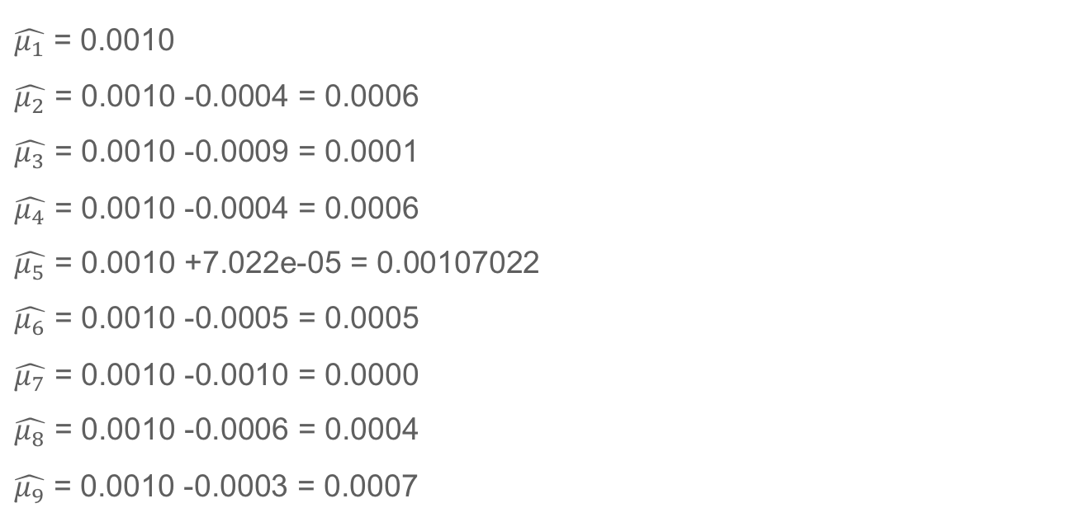
Calculation of Sample Means
ANOVA
$\hat{μ_{1}}$ = 0.0010
$\hat{μ_{2}}$ = 0.0010 -0.0004 = 0.0006
$\hat{μ_{3}}$ = 0.0010 -0.0009 = 0.0001
$\hat{μ_{4}}$ = 0.0010 -0.0004 = 0.0006
$\hat{μ_{5}}$ = 0.0010 +7.022e-05 = 0.00107022
$\hat{μ_{6}}$ = 0.0010 -0.0005 = 0.0005
$\hat{μ_{7}}$ = 0.0010 -0.0010 = 0.0000
$\hat{μ_{8}}$ = 0.0010 -0.0006 = 0.0004
$\hat{μ_{9}}$ = 0.0010 -0.0003 = 0.0007

Slide 48
Confidence Intervals for Model Parameters (alpha =0.01)
ANOVA
 | [0.005 | 0.995]
Intercept | -0.001 | 0.003
C(group)[T.2010] | -0.003 | 0.002
C(group)[T.2011] | -0.003 | 0.002
C(group)[T.2012] | -0.003 | 0.002
C(group)[T.2013] | -0.002 | 0.002
C(group)[T.2014] | -0.003 | 0.002
C(group)[T.2015] | -0.003 | 0.001
C(group)[T.2016] | -0.003 | 0.002
C(group)[T.2017] | -0.003 | 0.002

Slide 49
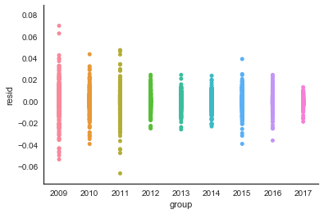
Diagnostics -- Residual Plot
ANOVA
The plot shows that the
residuals are distributed
around zero line, implying
that they have the same
zero mean. However, the
dispersion pattern indicates
unequal variance.

Slide 50
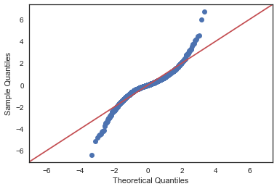
Diagnostics -- Q-Q plot
ANOVA
Normality assumption is
seriously violated in this
case. The result will be
verified by some numerical
tests later.

Slide 51
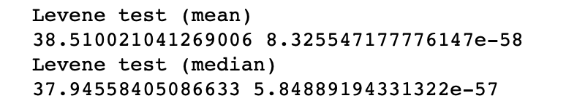
Diagnostics -- Homogeneity of Variances Tests
ANOVA
According to Python output, we have the following results:
→ Levene test of mean and median strong indicates unequal variance among groups. The p-value is so small that even at 99% significant level we would reject the homogeneous variance assumption.

Slide 52
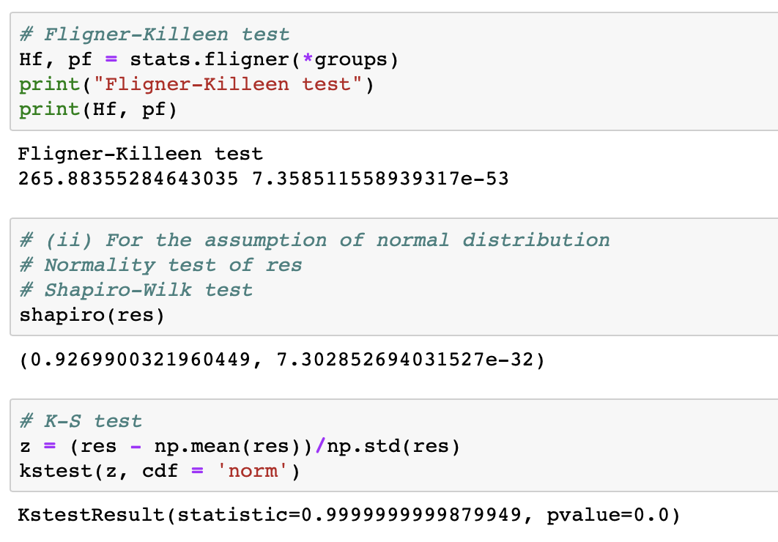
Diagnostics -- Normality Tests
ANOVA
Normality fails in both tests.

Slide 53
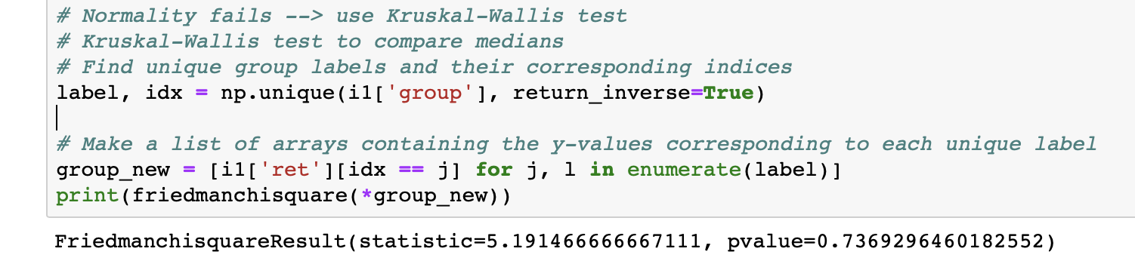
ANOVA
Remedy -- Kruskal test
The p-value is 0.7369, so we do not reject the null hypothesis
that normality holds.

Slide 54
05
Machine Learning
train_test_split
different classfiers
result comparasion
further work

Slide 55
train_test_split
train
validation
2010-01-04
2015-03-05
2018-11-15
objective:
direction of sp500 return next day: up(1) down(0)
Feature:
return of different index today
index chosen: SP500,FTSE100,NIKKEI225,USDGBP,USDJPY,DJIA,
NASDAQ,GOLDPRICE,crudeoil,SSECOPOSITE,HSI

Slide 56
Logistic Regression
Accuracy score | 55.13%
all label in validation data is predicted to be one, so the accuracy is just the up ratio in validation data.which means logistic regression fail to predict the direction of the data by these features

Slide 57
SVM
kernel | accuracy
rbf | 55.13%
linear | 55.13%
poly | 55.13%
sigmoid | 55.13%
svm fails to predict

Slide 58
K-means
Assumption : the feature can be clustered into two classes,
one is related to rise, another is related to fall, so we choose the
n_clusters=2 in Kmeans
cluster | ratio of rise
1 | 54.27%
2 | 54.11%
insignificant difference, asumption might fail

Slide 59
Random Forest
Choosing n_estimators = 100
depth | accuracy
2 | 54.78%
3 | 55.65%
4 | 55.83%
5 | 54.09%
6 | 55.30%
choosing depth = 4, accuracy = 55.83%

Slide 60
XGBoost
choosing n_estimators = 100
depth | accuracy
2 | 54.78%
3 | 55.65%
4 | 54.61%
5 | 54.43%
6 | 54.96%
choosing depth = 3, accuracy=55.65%
not much difference from random forest

Slide 61
Multi-Layer Perception
solver | accuracy
lbfgs | 55.30%
sgd | 55.13%
adam | 55.13%
choosing solver = lbfgs,accuracy=55.30%
other solver fails

Slide 62
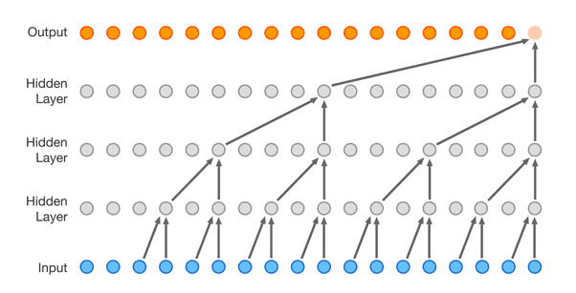
CNN

Slide 63
Choosing Feature :
index :sp500 FTSE100
feature: close open low high
Sequance_length = 20 , embeded_len = 8
Input_shape = (20,8)
Accuracy score | 54.51%

Slide 64
Confusion Matrix
confusion matrix
 | 0.172 | 0.706
 | 0.226 | 0.808

Slide 65
Different Classifier
model | result
Logistic Regression | fail
SVM | all kernel fail
K-means | fail
Random Forest | accuracy: 55.83%
XGBoost | accuracy: 55.65%
Multi-Layer Perception | lbfgs accuracy: 55.30%
CNN | accuracy:54.51%

Slide 66
further work
1、More feature to choose ：we just choosing the return one lag as
our input feature, we could choose two or more lag as our features.
we could also use some indicator to make prediction better, like William
percentage, moving average indicator.
2、Downsamplling：simple model just learn the distribution of the label,
so it might be necessary for us to doing downsample to make the times
of rise and fall equal before training.Then the model could learn more
from the features.

Slide 67
Thanks!

